Slide 1
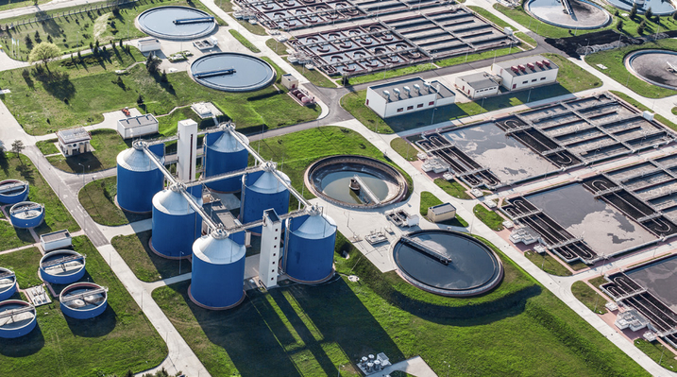
REOURCE RECOVERY FROM WASTE WATER
PRESENTED BY :-
PULKIT KUHWAHA ROLL:- 001510401130
CLASS:- BCE 4th year
Guided by :-
ASST. PROF. DR. ANUPAM DEB SARKAR
CIVIL ENGINEERING DEPARTMENT
JADAVPUR UNIVERSITY

Slide 2
INTRODUCTION
Driven by environmental, economic and ecological benefits, resource recovery from wastewater draws worldwide attention.
Major research efforts are focused on valorization and recovery of cellulose, bioplastics, medium-chain carboxylic acids and metals.
Water utilities can profit from green practices that might be of interest in terms of reputation management. Thus, the industry sector is more and more supportive for the concept of resource recovery.
Recovering resources from water-based waste streams must be both beneficial for the environment and economically attractive. A proper reflection on design of products and processes, market prospects, appropriate public policies and regulations, and institutional arrangements are fundamental for accelerating resource recovery.

Slide 3
BASIC CONCEPT OF RESOURCE RECOVERY
Energy plays a big role in the resource recovery sector, both since electricity is needed for the treatment process and since energy in different forms can be recovered in the treatment process.
Anaerobic digestion(AD) is the most typical method in which biosolids can be converted into energy. The process involves the readily biodegradable portion of the volatile solids in sludge which is transformed into biogas by microorganisms in the absence of oxygen.
Microbial fuel cells (MFC) are an alternative for AD. In the system, used water is treated at the same time as energy is produced through conversion of chemical energy into electrical energy. Ammonia can further be recovered through this process.
Many components can be recovered during the treatment process of used water and from residuals from water treatment, such as nutrients, metals and biodegradable plastic.

Slide 4
NUTRIENT RECOVERY
Nutrient recovery can be divided into three sections, namely accumulation, release and extraction in which nutrient products are recovered in the last step.
Phosphorus can be recovered from sludge is through supercritical water oxidation (SCWO), a technique which is growing in terms of practice and commercialization.
Nitrogenous materials present in the sewage or paper mill effluents can be removed from sewage effluent and converted into biomass through activated secondary treatment processes.
The electro dialysis technology is founded on the method of using an electrical current in which anions and cations are separated across ion exchange membranes. Multiple nutrients can be recovered through this process but it is most suitable for nitrogen and potassium. (see Figure 1)

Slide 5
FIGURE 1: Electro dialysis
BP: bipolar membrane; A: anion-selective membrane, C: cation-selective membrane;
M+: cation; X-: anion; H+: hydrogen ion; OH-: hydroxide ion; CH3O-: methoxide ion.

Slide 6
METALS
There are certain factors that need to be considered when recovering metals. Such features include initial concentrations of all metals, origin of used water, identification of metals to be recovered and the choice between recovering one specific metal opposed to a group of metals.
Used water content from industries such as mining, electrical and electroplating can contain traces of heavy metals such as cadmium, copper, zinc, gold, magnesium, silver and calcium.
Common methods of removing metals involve physiochemical techniques such as filtration, chemical filtration and solvent extraction. Removal can also be performed through adsorption, electrodialysis and through biological and membrane processes
Metal sulphides can be recovered using sulphate reducing bacteria (SRB), electrodialysis can recover metals such as Cr and Cu. Photocatalysis can recover noble metals from industrial waste effluents. Deposited metals can be extracted from slurry by mechanical and/or chemical means. Mercury (II), chromium (VI), silver (I) and iron (III) ions can be recovered using Cation-exchange.

Slide 7
PARTITION-RELEASE-RECOVER CONCEPT
Verstraete proposed separation of streams into major and minor concentrated and dilute streams.
Default sets of technologies identified were filtration based treatment (gravity-microfiltration-reverse osmosis), with treatment of solids and concentrate by anaerobic digestion, and recovery of the nutrients from digestate though (for example, electrodialytic nitrogen recovery, and phosphate precipitation).
This was further developed, as the “partition-release-recover” process, which uses biological agents to selectively remove nutrients and carbon from the liquid phase.
This is a combined and scalable process, able to treat wastewater at essentially zero energy input, and recover nitrogen, phosphorous, and potentially, value-added organics or microbial products from the effluent.
An overall scheme is shown in Figure2.

Slide 8
FIGURE 2: Enhancing the Partition-Release-Recovery concept for organic
and metals recovery from wastewater (PRR² concept).

Slide 9
BIODEGRADABLE POLYMER
The biosolids present in used water represent an ample carbon source that is available at no cost.
An advantage of the produced plastic is its lifespan of months which can be compared to the centuries needed to break down petroleum based plastics.
A suitable environment is necessary for the bacteria’s growth and there are multiple mature examples of technologies that perform this on scale already.
Figure 3 illustrates a prototype used for manufacturing such biodegradable plastics using biosolids

Slide 10
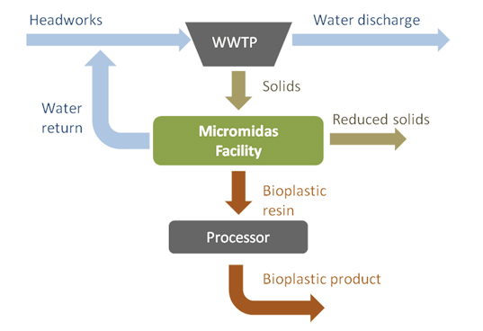
Figure 3: concept for manufacturing biodegradable plastics

Slide 11
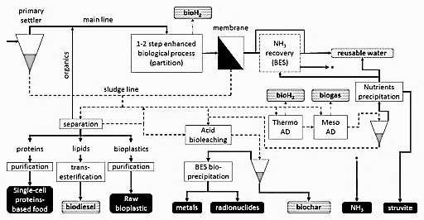
FIGURE 4: Conceptual overview of different biological technologies applied in wastewater treatment for energy and resource recovery.

Slide 12
APPLICATION OF RESOURCE RECOVERY IN MUNCIPAL SEWAGE
The two components in sewage sludge that are technically and economically feasible to recycle are nutrients (nitrogen (N) and phosphorus (P)) and energy (carbon).
P is fast becoming the most significant nutrient due to depleting sources.
Emerging technologies have been developed to extract this valuable resource including KREPO, Aqua Reci, Kemicond, Bio Con, SEPHOS and SUSAN, and are based on physical-chemical and thermal treatment to dissolve the P, with final recovery by precipitation.
Other resources recovered include the reuse of sludge for construction materials, heavy metals, poly hydroxyl alkanoates (PHA), proteins, enzymes and volatile fatty acids(VFA).
Table1 gives an overview of resource recovery products from sewage sludge, their typical values and uses.

Slide 13
Table 1: Resource recovery products from sewage sludge

Slide 14
APPLICATION OF RESOURCE RECOVERY IN INDUSTRIAL AND AGRICULTURE WASTEWATER
Wastewater contains valuable nutrients (NPK), which may either be recovered as a resource or recycled when treated wastewater is reused for irrigation or other applications.
these nutrients aid crop growth and could reduce the need for synthetic fertilizers in India by up to 40%.
In industrial wastewater resource recovered be of sludge for construction materials, heavy metals, poly hydroxyl alkanoates (PHA), proteins, enzymes, etc.
The various methods of treatment are as follows- Anaerobic Process, Aerobic treatment, Physico-chemical treatment, Adsorption, Membrane treatment, Electrodialysis, Evaporation/combustion.

Slide 15
FURUTE PROPECT OF RESOURCE RECOVERY
Apart from a continuous flow of technological advances, advancing resource recovery requires using an interdisciplinary and integrated approach and incorporating sustainability measures in treatment plants.
Integrated Resource Recovery at the Centralized Level-A phenomenon that has evolved in recent years and that is predicted to further develop is using a holistic approach when planning and implementing resource recovery technologies
Incorporation of Sustainability Measures-plants would also be self-sufficient for energy and cost effective. While recovering new material and have water quality which meets or enhances set uses. The initiated effort would lead to minimizing the carbon footprint and greenhouse gases emissions.
An idea is to further create a certification with a specific environmental management system for such facilities which can promote their sustainability and good stewardship. In order to create such an accreditation life cycle assessments (LCAs) will likely increase, a trend which is already seen in companies and projects.

Slide 16
COST EFFICTIVNESS OF RESOURCE RECOVERY
A detailed economic analysis was done comparing conventional activated sludge with emerging technologies, including high-rate activated sludge, photo-membrane bioreactors, and mainline anaerobic treatment (Burgess et al., 2015).
This used commodity products (e.g., electricity, nitrogen, phosphorous). This showed that next generation technologies (assessed as a complete wastewater treatment platform) are generally capital cost neutral vs existing technologies, and likely competitive particularly at larger scale.
However, given the product value is relatively low (mainly electricity, bulk nutrients), there is not a strongly compelling economic driver to use next generation processes, given its higher risk. However, another consideration in the future is the value of carbon separate from the energy value in the wastewater.
In most of the cases, the technology readiness level (TRL) of the enabling technologies is still low (below TRL), needing dedicated economic analyses like Life Cycle Assessment once pilot or demonstration plants are implemented.

Slide 17
CONCLUSION
The usage of recovered resources can be a method in curbing current trends of exhausting the biosphere, a notion increasingly accepted and realized in multiple sectors.
The pool of technologies recovering water, energy and different types of value-added components are continuously expanding. This movement is positive, as a gap between consumption and worldwide supply of certain resources is evident and is predicted to become even more severe.
Regulations and policies and social acceptance are important factors that need to work in favor of continued innovation and adoption. It is important to continuously encourage resource recovery.
Apart from having resources to recover, advantageous regulations and policies are needed, as well as a demand and acceptance of the recovered product and recovery .Figure 5.1 provides a schematic view of what such a procedure could look like.

Slide 18
Figure 8.1 Schematic View of Resource Recovery

Slide 19
REFERENCES
Resource Recovery from Wastewater by Biological Technologies: Opportunities, Challenges, and Prospects, published: 06/January/2017 doi:10.3389/fmicb.2016.02106
RESOURCE RECOVERY & REUSE SERIES 8,International Water Management Institute (IWMI).CGIAR Research Program on Water, Land and Ecosystems(WLE). 57p. (Resource Recovery and Reuse Series 8). doi:10.5337/2016.203
Wastewater Engineering: Treatment and Resource Recovery ,Publisher : McGraw-Hill Education 2013-10-16,page (984-1259)
Resource recovery from sewage sludge(pdf) https://www.researchgate.net/publication/277775028_Resource_recovery_from_sewage_sludge
Treatment of Sugarcane Industry Effluents: Science & Technology issues, M. Rais Int. Journal of Engineering Research and Applications, ISSN : 2248-9622, Vol. 5, Issue 1( Part 2), January 2015, pp.11-19
ENVIRONMENTAL MANAGEMENT IN PULP AND PAPER INDUSTRY http://www.icontrolpollution.com/articles/environmental-management-in-pulp-and-paper-industry-.pdf

Slide 20


